Slide 1
PWM Drawer
Eng/ Abdullah Abdelgalel
Group : D54

Slide 2
TABLE OF CONTENTS
01
03
02
04
Overview
Program
Program Architecture and Modules
Test Results

Slide 3
01
OVERVIEW

Slide 4
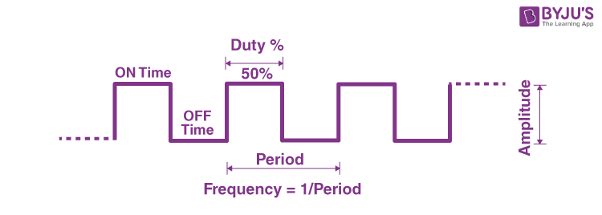
INTRODUCTION
Pulse Width Modulation (PWM) is a widely used technique in electronics and electrical engineering for controlling the power delivered to electronic devices. PWM provides a means to efficiently regulate the average power supplied to a load by varying the duty cycle of a pulsating signal. The PWM Drawer Application is a software tool designed to facilitate the generation and customization of PWM signals for a variety of applications.

Slide 5
SOME APPLICATIONS
Motor Control:
Regulate the speed and torque of motors with precision, crucial for robotics and industrial automation.
LED Dimming:
Achieve dynamic lighting effects and energy efficiency in LED applications.
Power Supply Regulation:

Slide 6
02
Program Architecture and Modules

Slide 7
Layerd Architecture
Application Layer
PWM Drawer
Hardware Abstraction Layer (HAL)
Microcontroller Abstraction Layer (MCAL)
PWM_Drawer
GLCD
DIO PWM ICU

Slide 8
03
Program

Slide 9
PWM Drawer Program
Initilization
Initialize PWM
Initialize ICU
Initialize GLCD
Measure Signal
Get Duty Cycle from ICU
Draw Signal

Slide 10
PWM Drawer Program
Clear Input capture Flag Set Triggering Edge : Rising Edge
Measure Signal
Wait for Input Capture
(High Count)
Clear Input capture Flag and Timer Counter Set Triggering Edge :
Rising Edge
Wait for Input Capture
(Start)
Clear Input capture Flag and Timer Counter Set Triggering Edge :
Falling Edge
Wait for Input Capture
(Low Count)

Slide 11
PWM Drawer Program
Display Pattern until max pixel width (128)
Draw Signal Shape
Display Falling Edge
Display Rising Edge
Display Pattern For
Low Time
Display Pattern for
High Time
Display Low Line Pattern
Display High Line Pattern

Slide 12
04
Test Results

Slide 13

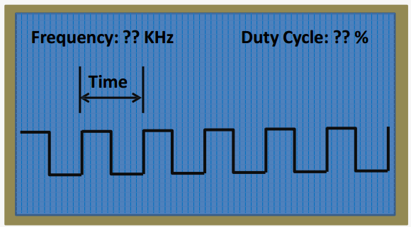
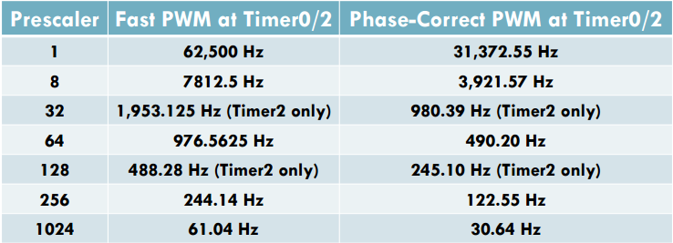
Note : All Generated PWM waves are generated from Timer 0. The Discussed Test Cases are for Fast PWM waves generated from the Microcontroller Atmega32.

Slide 14
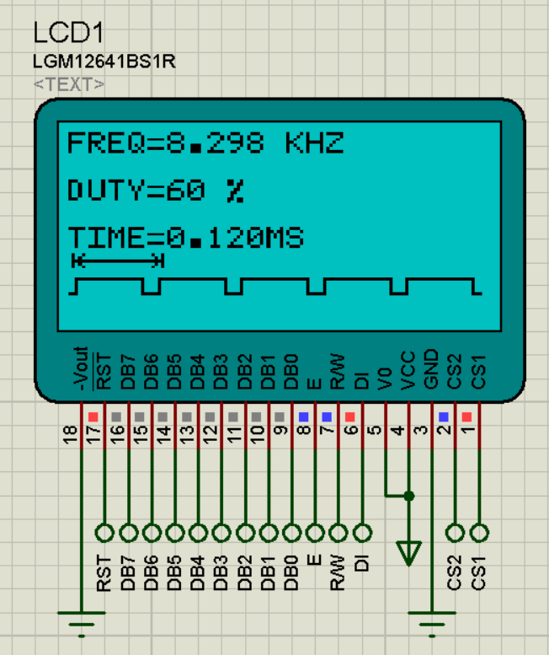
Test Case 1
Prescaler : 8
Duty : 60%
Expected output Frequency : 7.8125 KHz
Output Frequency : 8.298 KHz

Slide 15
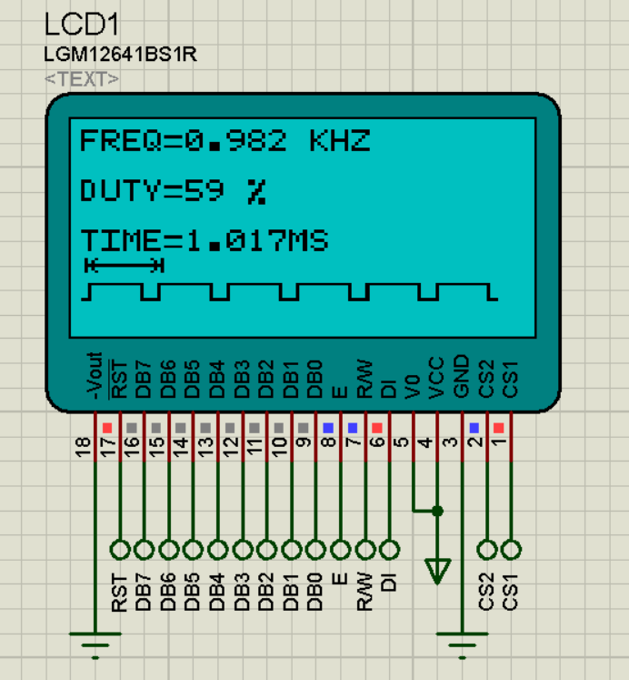
Test Case 2
Prescaler : 64
Duty : 60%
Expected output Frequency : 0.9765 KHz
Output Frequency : 0.982 KHz

Slide 16
THANKS!
Do you have any questions?
aabduljalil70@gmail.com
+20 1030148185

